Slide 1
Machine Learning Final Project
Exploring the efficacy of machine learning (ML) in characterizing exoplanets into different classes. The source of
the data used in this work is University of Puerto Rico's Planetary Habitability Laboratory Exoplanets Catalog
(PHL-EC). Performing a detailed analysis of the structure of the data and proposing methods that can be used to
effectively categorize new exoplanet samples.

Slide 2
Pre-processing
Although the number of missing values in ts max, min, mean is 54%, we cannot drop them since temperature is an important feature to classify exoplanets. Thus, excluding those columns, we can ignore all the columns with missing values more 25%.
Dropped rows with more than 40% missing values.
Replaced missing values in categorical columns with mode, missing values in columns with outliers with median and others with mean. This was done by calculating the contribution of outliers to mean.
It is found that there are 14 categorical, 4 discrete columns and 39 continuous columns.
Since the count of hypopsychroplanet and thermoplanet are very less, we can as well ignore them, finally cutting down the classes to three-
Non-Habitable
MesoPlanet
PsychroPlanet

Slide 3
Since we cannot just randomly do dimensionality reduction , we go through every column and dropped the columns: P. Disc. Method- method of discovery, P. Disc Year- year of discovery, P. Hab Moon-ﬂag indicating planet’s potential as a habitable exomoons, P.interior ESI-interior earth similarity index, P.surface ESI -surface earth similarity index . Since we have P. ESI, we ignore these values, Stype-type of parent star, S. Constellation-name of constellation
Since we have the mean, we drop these features like P. SFlux Min (EU), P. SFlux Max (EU), P. Teq Min (K), P. SFlux Min (EU)
Again, there may be some columns with more than one unique value, but one value that has insignificant frequency in the data set. Finding and dropping any columns with unique values that appear fewer than four times was planned. However, as the frequency of every unique value in each column is not very less, we do not drop any column.
There are 8 categorical values,3 discrete values, 35 continuous values now.
This concludes the Data-preprocessing Part of the dataset, now ready for analysis.

Slide 4
Models Explored
Following are the models applied on the dataset, followed by the accuracy achieved:
K-Nearest Neighbours:
Euclidean distance was found. With k=3, the nearest neighbours were found and the class is found
Weighted KNN:
weighted kNN was used so as to give more weight to the points which are nearby and less weight to the points which are farther away.
Naive Bayes:
A Gaussian naive bayes algorithm was written that predicted the class with highest probability calculated using Bayes theorem.
Decision Tree:
Decision Trees are built by repeatedly splitting training data into smaller and smaller samples.
Random Forest:
Random forests are an ensemble learning method for classification that operates by constructing a multitude of decision trees at training time and outputting the class that is the mode of the classes (classification) of the individual trees. This model was implemented on the already implemented decision tree

Slide 5
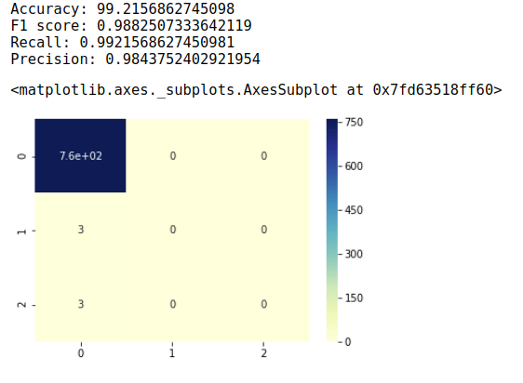
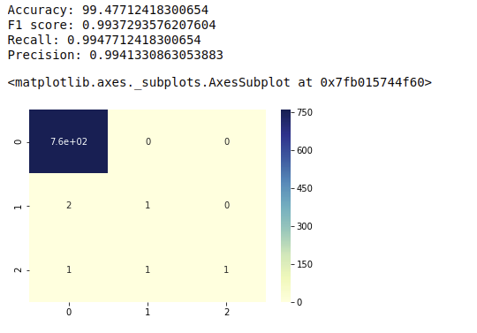
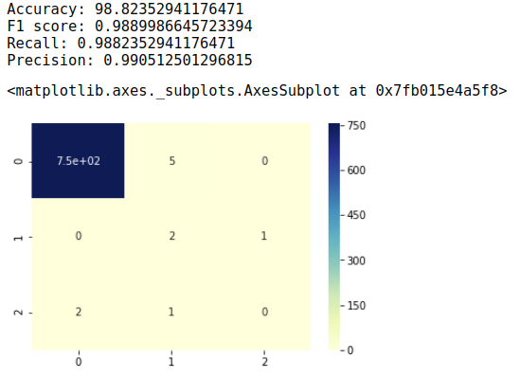
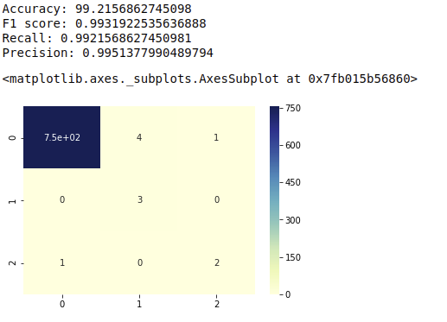
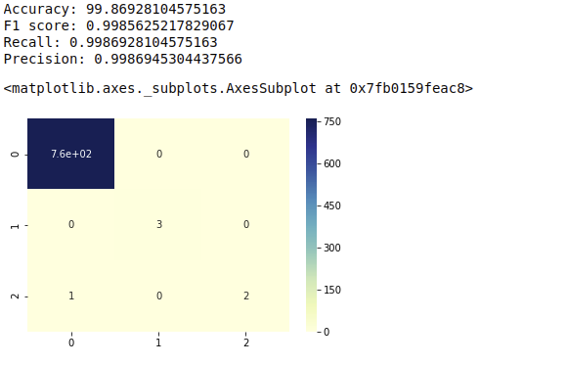
Naive Bayes
Random Forest
Weighted KNN
KNN(k=3)
Decision Tree

